Slide 1
2.4GHz Jammer
Patrick Wilkinson

Slide 2
Section Header01
Subtitle

Slide 3
Section Header02
Subtitle

Slide 4

Who am I
Patrick Wilkinson
Undergrad at the University at Buffalo
Studying Computer Science with a focus in Software Systems
Primary interests; Low Level Programing, Systems, and Hardware

Slide 5
Problem: Remote Trigger on 2.4 GHz
A Problem modern military units face is the Improvised Explosive Devices (IED’s). In Iraq and Afghanistan more services members were killed from IED’s than any other cause. Often these explosives were triggered remotely with anything from a tv remote, car key, to wired panels, and cell phones. To combat this often units would carry jammers with varying success. The best solution was found to be armoring vehicles against this threat. I aim to make a jammer operating on the frequencies commonly used (2.4 GHz) that is smaller than what was in common use during these wars. This has further use within Law Enforcement to counter Terrorism, especially if these devices can be made smaller.

Slide 6



Phases of Project
Phase 1
Research project and plan out design
Phase 2
Assemble, build, code, and implement
Phase 3
Present final product

Slide 7
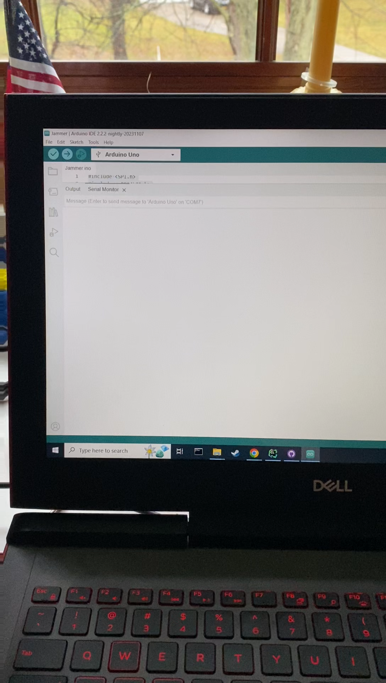
Demo
More in depth demo given to TA

Slide 8
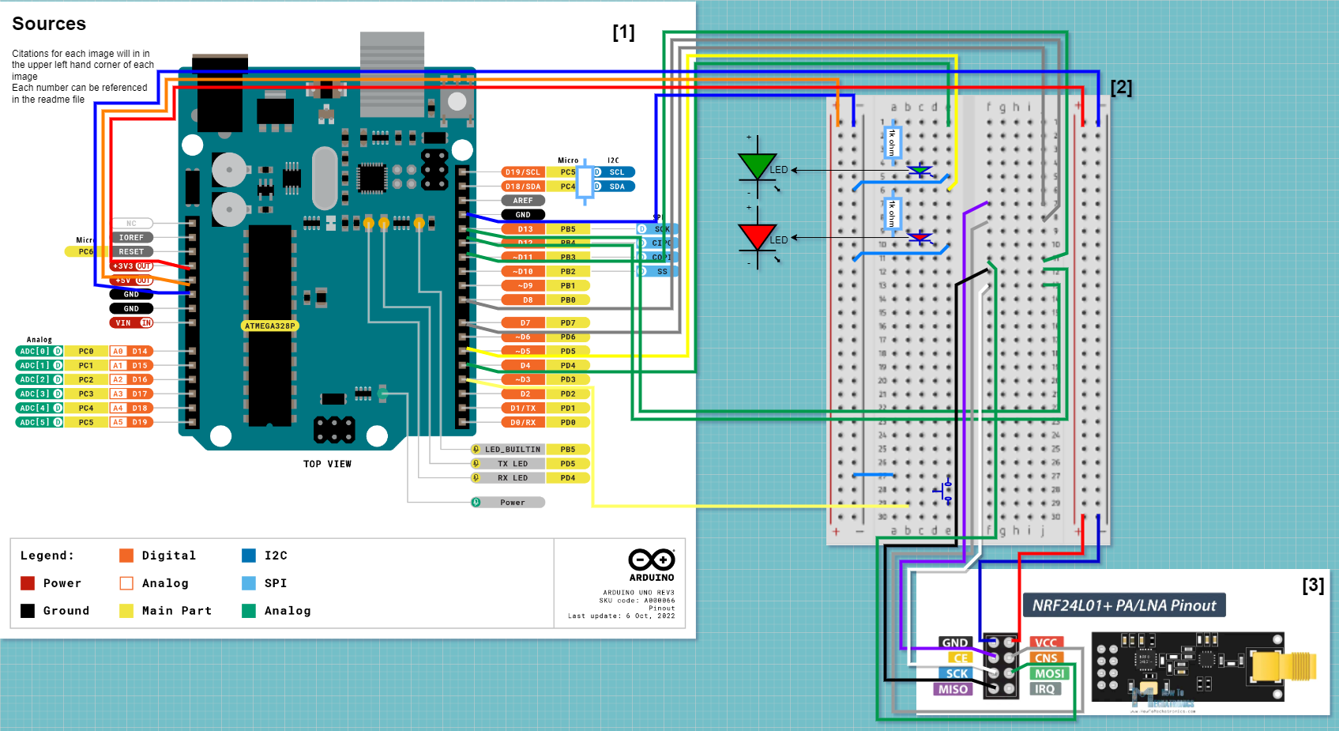
Components
Hardware:
This project uses an Arduino Uno R3 for its power supply, microcontroller, and attachments
2 LED’s and with 2 1k ohm Resistors
1 tactile button
1 NRF24L01 + PA/LNA
1 mini breadboard
Male to male and female to male wires

Slide 9
Sources 1) Arduino Uno Rev3 Pinout Diagram: https://content.arduino.cc/assets/A000066-full-pinout.pdf 2) Mini Breadboard Diagram: https://static.javatpoint.com/blog/images/breadboard.png 3) NRF24L01 + PA/LNA Pinout Graphic: https://howtomechatronics.com/wp-content/uploads/2017/02/NRF24L01-Pinout-NRF24L01-PA-LNA-.png References TMRh20,Avamander RF24: A NRF24L01+ Library [Software]. https://github.com/nRF24/RF24 Arduino Code Documentation: https://www.arduino.cc/reference/en/ Editorial Team - Everything RF. October 6, 2018. 2.4 GHz Wi-Fi 802.11b/g/n Channels and Frequency Band. https://www.everythingrf.com/community/2-4-ghz-wi-fi-802-11b-g-n-channels-and-frequency-band

